Slide 1
Supercharge Your User Interfaces in JSL
JMP Discovery 2018 Conference October, 2018
Peter Mroz
Statistical Programming Janssen Research & Development
Justin Chilton
JMP Development Testing
SAS

Slide 2
Agenda
Introduction
Col Boxes
Tabs
Too Many Tabs
Associative Arrays
Tree Nodes and Tree Boxes
Filtering Long Picklists

Slide 3
Introduction
Application user interfaces should be
Easy to use
Easy to understand
Transparent to the user
Good user interfaces result in
Engaged users
Fewer frustrations
Great user experiences
This talk:
Variety of ways to supercharge your JMP user interfaces

Slide 4
Col Boxes
Special type of column object that can contain any other display box
Contained inside a Table Box
Allows you to display
Text in different fonts, styles, sizes, foreground/background colors in a Table Box grid
A column of clickable buttons
A column of icons representing the status of a row
A column of mini-graphs
A column of pictures

Slide 5
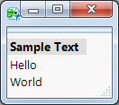
Simple Col Box Example (1)
// Simple Col Box Example.jsl
nw = new window("Col Box Example",
tb = table box(
cb = col box("Sample Text",
tb1 = text box("Hello"),
tb2 = text box("World")
)
)
);

Slide 6
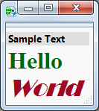
Simple Col Box Example (2)
// Format the text boxes
tb1 << font color("Dark Green")
<< set font("Times New Roman", 24, "bold");
tb2 << font color("Dark Red")
<< set font("Broadway", 24, "italic");

Slide 7
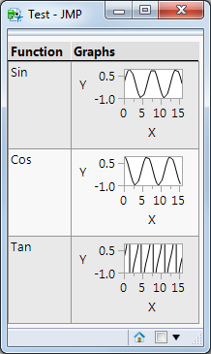
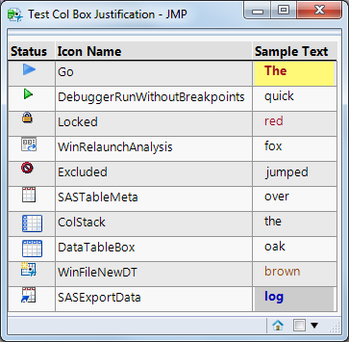
Col Box Examples
Col Box Graph Function Example.jsl
Col Box icons formatted text Example.jsl

Slide 8
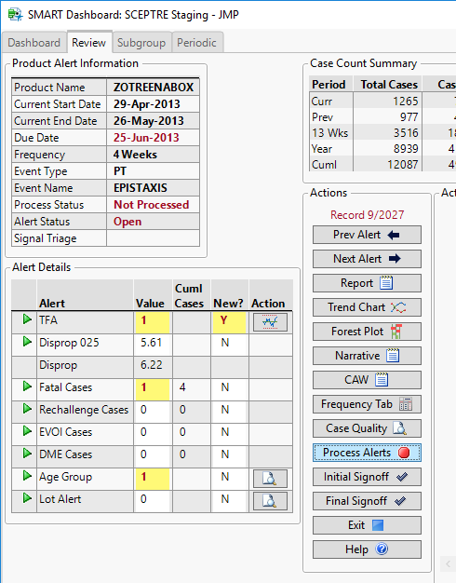
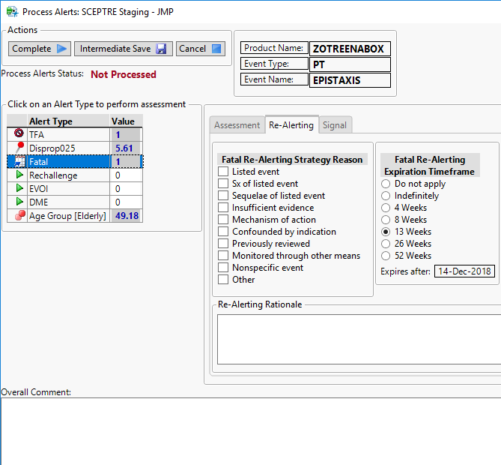
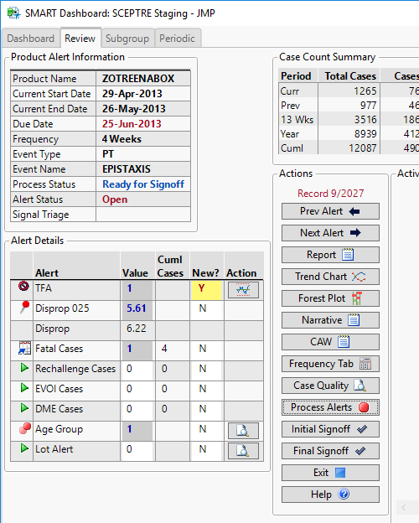
Real World Example – Adverse Event App
Review adverse events that have alerted

Slide 9
Table Box Tip
Make rows clickable
<< set selectable rows(1);
Add actions
<< set row change function()

Slide 10
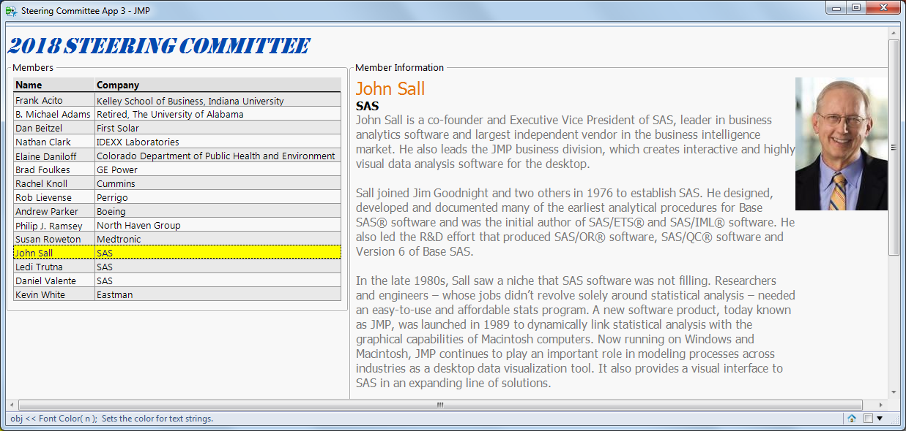
Steering Committee Example
Steering Committee.jsl + Steering Committee.jmp

Slide 11
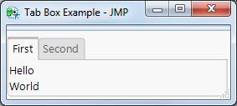
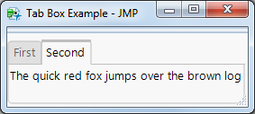
Tab Boxes
Segment displays using a tabbed interface
// Example Tab Box.jsl
nw = new window("Tab Box Example",
tb = tab box(
"First Tab",
vlistbox(
text box("Hello"),
text box("World")
),
"Second Tab",
text box("The quick red fox jumps over the brown log")
)
);

Slide 12
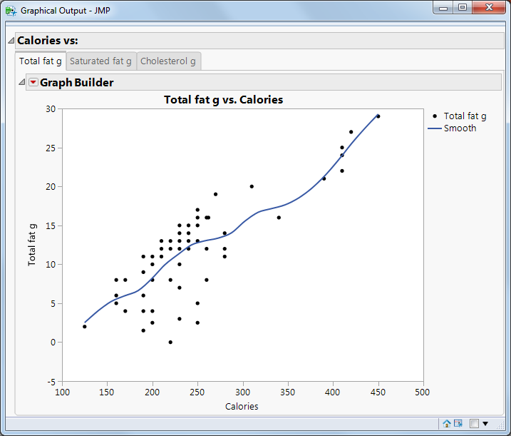
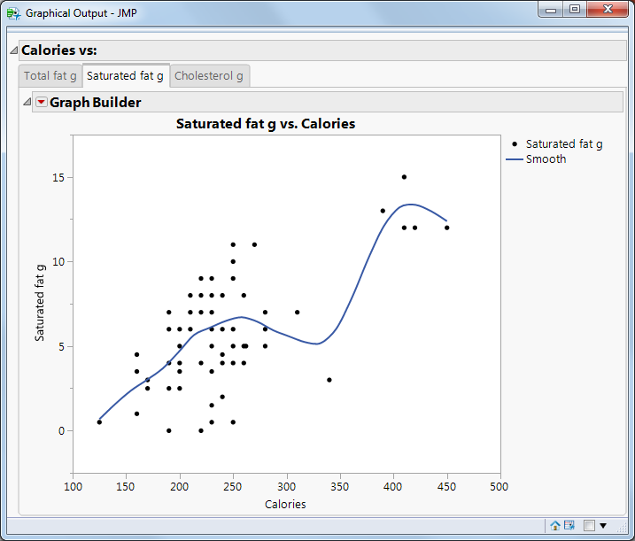
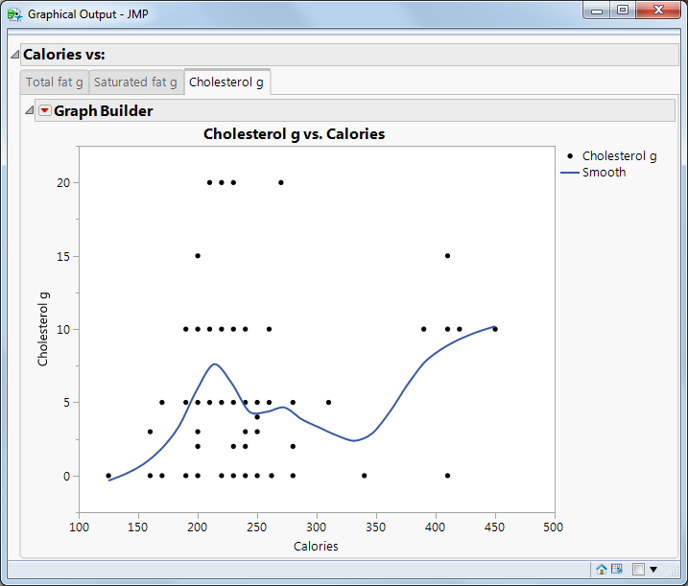
Using Tab Boxes to Display Graphs
Each tab shows a separate graph in a series
Tabbed_graphs.jsl

Slide 13
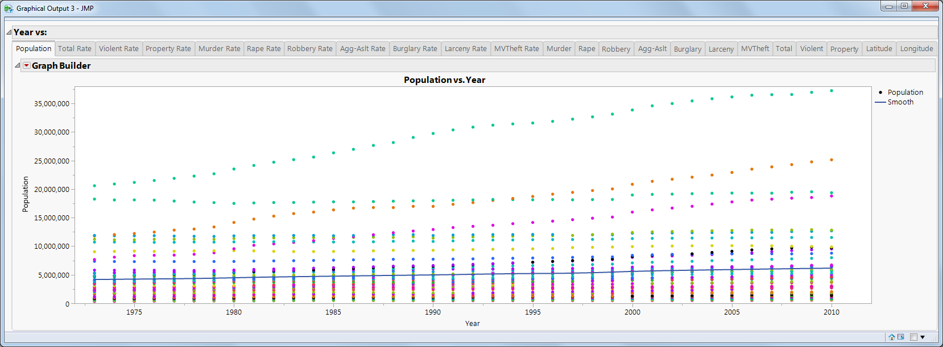
Tab Boxes are Great
But what if there are too many tabs?
TooManyTabs_Graphs.jsl

Slide 14
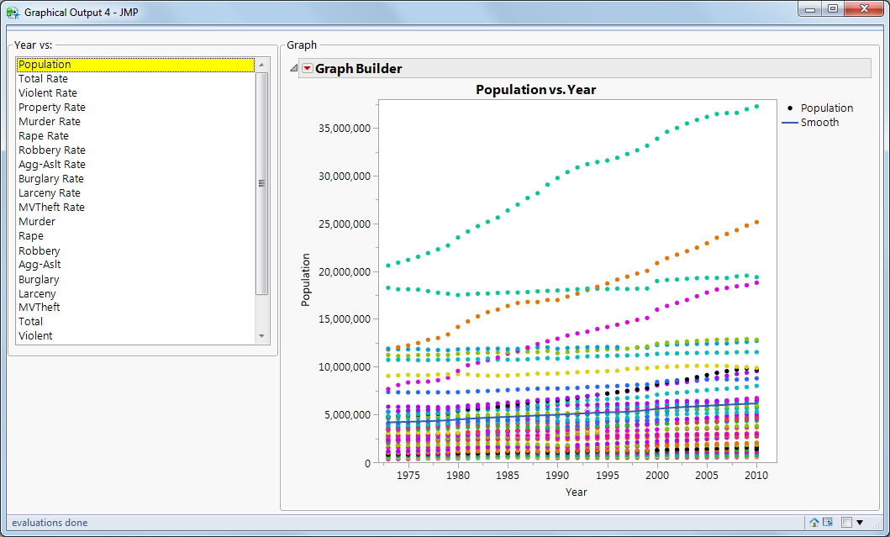
Use a List Box, and Display One Graph at a Time
Listbox_Graphs.jsl

Slide 15
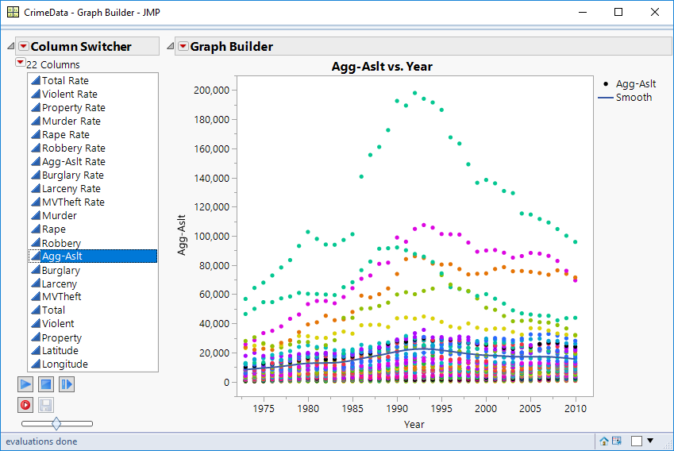
Note:
Achieve the same effect using column switcher
Listbox approach still useful

Slide 16
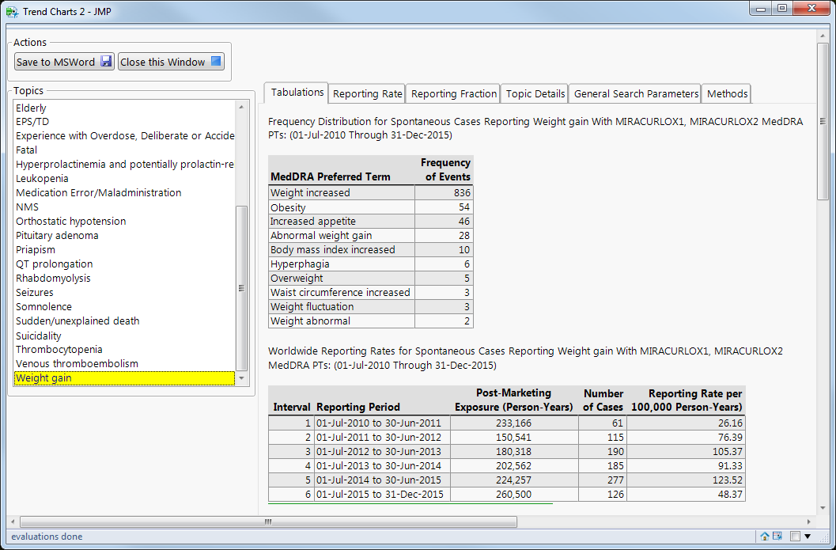
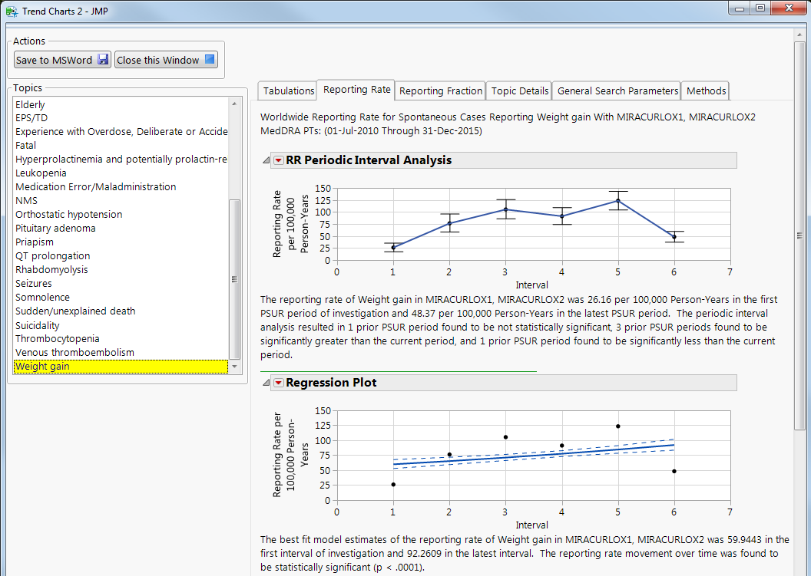
Real World Example 2: Trending App
Show trending information for many topics

Slide 17
Associative Arrays
From the JSL Scripting book:
Map unique keys to values that can be non‐unique
Also called a dictionary, a map, a hash map, or a hash table
Keys are placed in quotes
The value associated with a key can be a number, date, matrix, list, and so on.

Slide 18
Example
aa = associative array();
aa["First"] = {"Tom", "Jerry"};
aa["Second"] = {"Fred", "Wilma"};
aa["Third"] = {"Pebbles", "Bam Bam"};
print(aa);
Associative Array({
{"First", {"Tom", "Jerry"}},
{"Second", {"Fred", "Wilma"}},
{"Third", {"Pebbles", "Bam Bam"}}
})

Slide 19
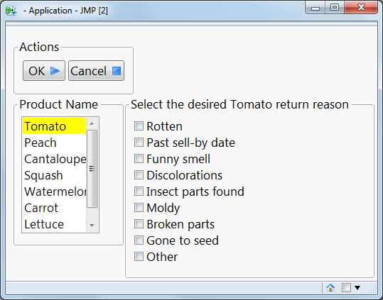
Product Returns Application
Click on product, select return reason(s)
If another product selected
Store return reasons for previously selected product
Display return reasons for newly selected product
AssociativeArrayExample.jmpapp

Slide 20
Associative Arrays to the Rescue
// Use an associative array to store the return checkboxes for each product name
// Initialize associative array
return_aa = associative array();
n_return = nitems(return_cb << get items());
// Create a one-dimensional matrix of 0s
empty_list = j(n_return, 1, 0);

Slide 21
Associative Arrays to the Rescue
// Use an associative array to store the return checkboxes for each product name
// Initialize associative array
return_aa = associative array();
n_return = nitems(return_cb << get items());
// Create a one-dimensional matrix of 0s
empty_list = j(n_return, 1, 0);
// Get product names from product listbox
product_list = product_lb << get items;
for (i = 1, i <= nitems(product_list), i++,
one_product = product_list[i];
return_aa[one_product] = empty_list;
);

Slide 22
Initial Values for Associative Array
return_aa:
Associative Array({
{"Cantaloupe", [0, 0, 0, 0, 0, 0, 0, 0, 0]},
{"Carrot", [0, 0, 0, 0, 0, 0, 0, 0, 0]},
{"Cucumber", [0, 0, 0, 0, 0, 0, 0, 0, 0]},
{"Lettuce", [0, 0, 0, 0, 0, 0, 0, 0, 0]},
{"Peach", [0, 0, 0, 0, 0, 0, 0, 0, 0]},
{"Squash", [0, 0, 0, 0, 0, 0, 0, 0, 0]},
{"Tomato", [0, 0, 0, 0, 0, 0, 0, 0, 0]},
{"Watermelon", [0, 0, 0, 0, 0, 0, 0, 0, 0]}})

Slide 23
When checkboxes are checked or unchecked…
// Called when the return_cb check box selection changes
return_cbChange=Function({this, index},{selected},
one_product_list = product_lb << get selected;
if (nitems(one_product_list) > 0,
one_product = one_product_list[1];
);
// Get the status of the recently checked or unchecked checkbox
one_checked = this << get(index);
// Save the checkbox status for this product name/return element
return_aa[one_product][index] = one_checked;
);

Slide 24
When the product name changes…
// This function is called when the product_lb List Box selection changes
product_lbSelect=Function({this},{selectedIndex},
one_product_list = this << get selected;
if (nitems(one_product_list) > 0,
one_product = one_product_list[1];
// Put the newly selected product name into some labels
return_panel << set title("Select the desired " ||
one_product || " return reason");
// Set the return_cb checkboxes to this product’s values
for (i = 1, i <= n_return, i++,
return_cb << set(i, return_aa[one_product][i]);
);
);
);

Slide 25
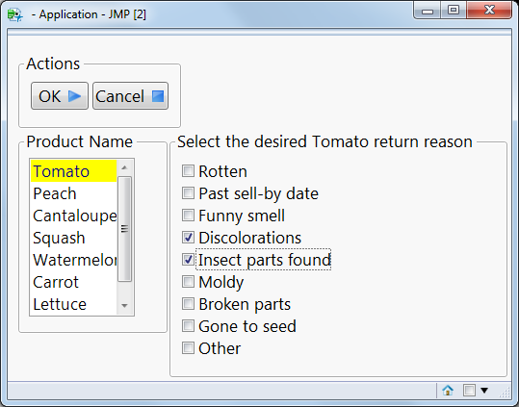
Returns Associative Array with some Checkboxes Checked
Associative Array({
{"Cantaloupe", [0, 0, 0, 0, 0, 0, 0, 0, 0]},
{"Carrot", [0, 0, 0, 0, 0, 0, 0, 0, 0]},
{"Cucumber", [0, 0, 0, 0, 0, 0, 0, 0, 0]},
{"Lettuce", [0, 0, 0, 0, 0, 0, 0, 0, 0]},
{"Peach", [1, 1, 0, 0, 0, 0, 0, 0, 0]},
{"Squash", [0, 0, 0, 0, 0, 0, 0, 0, 0]},
{"Tomato", [0, 0, 0, 1, 1, 0, 0, 0, 0]},
{"Watermelon", [0, 0, 0, 0, 0, 0, 1, 1, 0]}})

Slide 26
Tree Nodes and Tree Boxes
Tree Node
A tree data structure in JMP that can be displayed using a Tree Box.
Has a label, which appears in the Tree Box, but also can hold data (any JMP object).
Tree Box
Shows Tree Nodes, allowing you to select and collapse the nodes as desired.
Can have various kinds of callback functions, which are useful when updating a window based on selection.

Slide 27
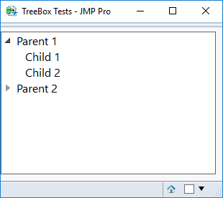
Simple Tree Box Example
root1 = Tree Node( "Parent 1" );
root2 = Tree Node( "Parent 2" );
c1 = Tree Node( "Child 1" );
c2 = Tree Node( "Child 2" );
c3 = Tree Node( "Child 3" );
c4 = Tree Node( "Child 4" );
root1 << Append( c1 );
root1 << Append( c2 );
root2 << Append( c3 );
root2 << Append( c4 );
nw = New Window( "TreeBox Tests",
tree = Tree Box( {root1, root2}, Size( 300, 200 ) )
);
tree << Expand( root1 );

Slide 28
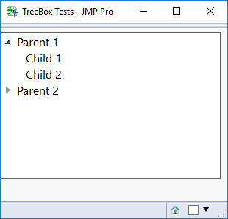
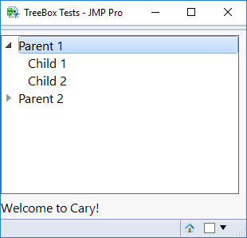
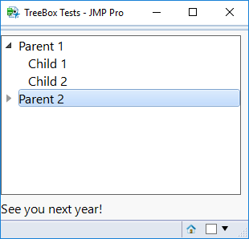
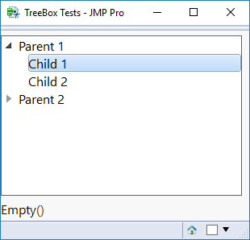
Adding Data to Tree Nodes
// add a text box to the window
nw << Append( tb = Text Box() );
// add some data to the root nodes
root1 << Set Data( "Welcome to Cary!" );
root2 << Set Data( "See you next year!" );
// add a callback function when selecting a node
tree << Set Node Select Script(
Function({tree, node},
If( !Is Empty( node ),
tb << Set Text( Char( node << Get Data() ) )
)
)
);

Slide 29
Candy Bars Example - Demo
Candy Bar Nutrition.jsl

Slide 30
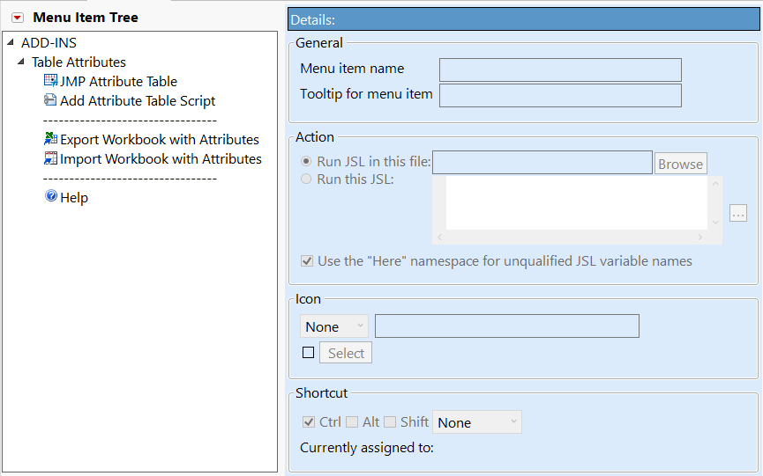
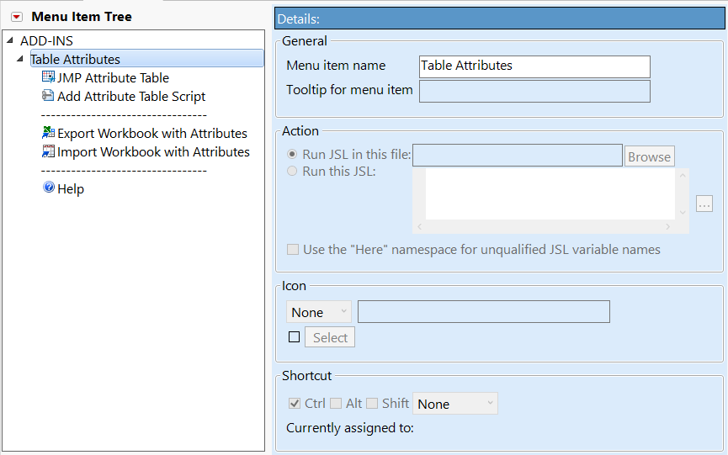
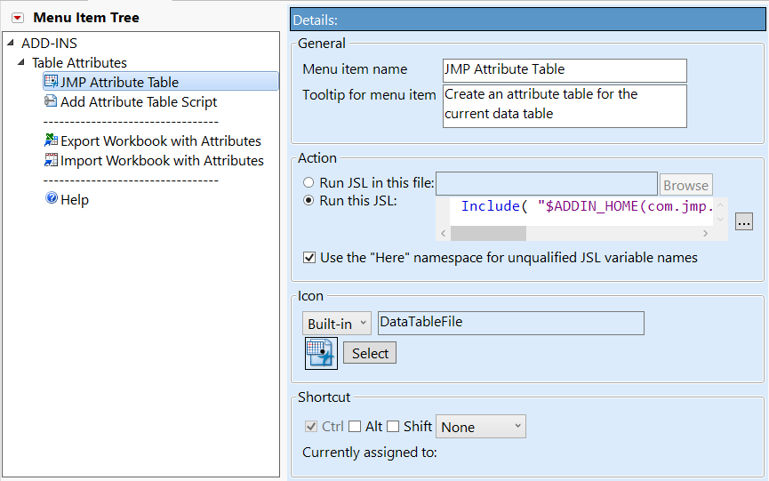
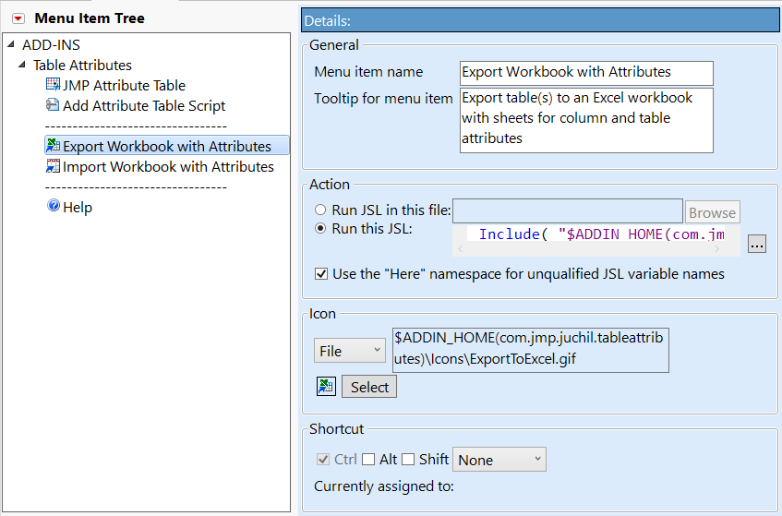
Real World Example – Add-In Manager

Slide 31
Filtering Long Picklists
Sometimes there are just too many items in a list box to find what you are looking for.
Implementing your own search box can help reduce the need for scrolling through these items.

Slide 32
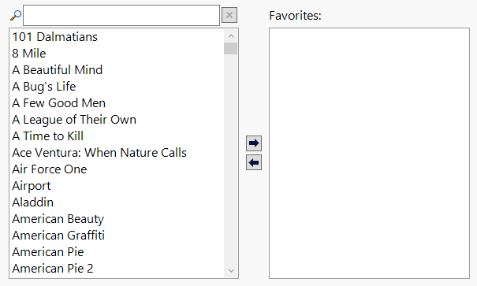
Filtering Long Picklists – Single Select

Slide 33
Filtering Long Picklists – Multiselect

Slide 34
Search Box
H List Box(
Align( "Center" ),
Icon Box( "SearchIndex" ),
filter_teb = Text Edit Box( "",
<<Set Width( 250 ),
<<Set Text Changed( filterMovies )
),
Button Box( "",
<<Set Icon( "TabClose" ),
<<Set Script(
// clear the filter and call the text changed function
filter_teb << Set Text( "" );
filterMovies( filter_teb, "" );
),
<<Set Tip( "Clear Filter" )
)
)

Slide 35
Filter Function
filterMovies = Function( {this, searchText},
{filtered_movies, i},
// only attempt to filter if there is any text
If( searchText != "",
// new list for movies that match searchText
filtered_movies = {};
// Check if each movie matches the given text
For( i = 1, i <= N Items( all_movies_list ), i++,
// Insert to our list if it contains our search text (case insensitive)
If( Contains( Lowercase( all_movies_list[i] ), Lowercase( searchText ) ),
Insert Into( filtered_movies, all_movies_list[i] );
)
);
,
// else show all movies
filtered_movies = all_movies_list;
);
nonFavMovies_lb << Set Items( filtered_movies );
);

Slide 36
Favorite Movies Example - Demo
Favorite Movies.jsl

Slide 37
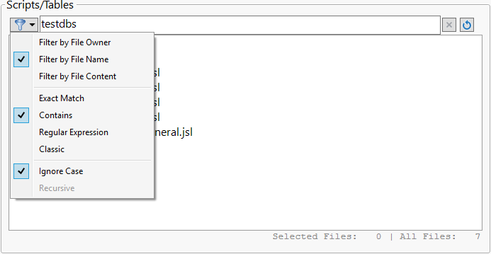
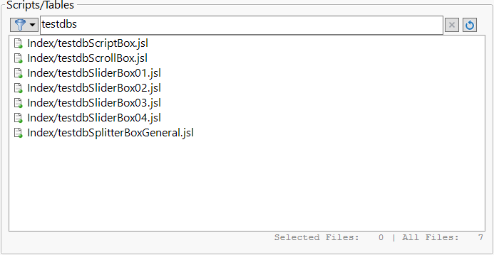
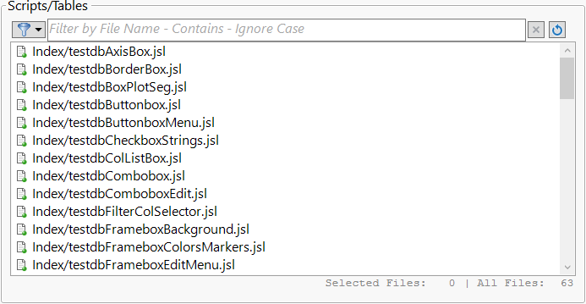
Real World Example – JMP Testing Framework

Slide 38
Conclusions
Col boxes are a useful addition to a tablebox
Tab boxes are great for segmenting displays
Associative arrays are useful for storing complex state information
Tree nodes and tree boxes are excellent for working with hierarchical data
Filtering long picklists can easily be done in JSL

Slide 39
Principles of User Interface Design (Joshua Porter*)
Clarity is job #1
Interfaces exist to enable interaction
Conserve attention at all costs
Keep users in control
Direct manipulation is best
One primary action per screen
Keep secondary actions secondary
Provide a natural next step
Appearance follows behavior
Consistency matters
Strong visual hierarchies work best
Smart organization reduces cognitive load
Highlight, don't determine, with color
Progressive disclosure
Help people inline
A crucial moment: the zero state
Great design is invisible
Build on other design disciplines
Interfaces exist to be used
* http://bokardo.com/principles-of-user-interface-design/

Slide 40
Principles of User Interface Design (Joshua Porter*)
Clarity is job #1
Interfaces exist to enable interaction
Conserve attention at all costs
Keep users in control
Direct manipulation is best
One primary action per screen
Keep secondary actions secondary
Provide a natural next step
Appearance follows behavior
Consistency matters
Strong visual hierarchies work best
Smart organization reduces cognitive load
Highlight, don't determine, with color
Progressive disclosure
Help people inline
A crucial moment: the zero state
Great design is invisible
Build on other design disciplines
Interfaces exist to be used
* http://bokardo.com/principles-of-user-interface-design/

Slide 41

Key Learnings
Listen to your users
Listen some more
Keep listening!
Don’t say no right away
Show prototypes
Users don’t know what they want until they see what they don’t want

Slide 42
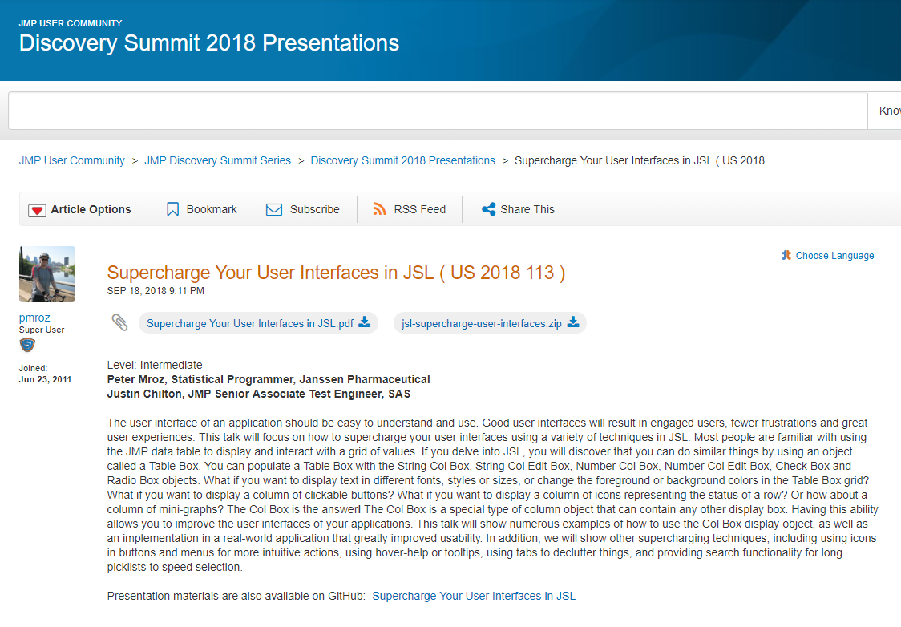

Slide 43
Thank you
Peter Mroz Justin Chilton
pmroz@its.jnj.com Justin.Chilton@jmp.com

